Slide 1
Pitch Template
By: Bryan Barringer

Slide 2
Idea Discovery Canvas (IDC)
The IDC was developed to assist entrepreneurs in mapping out a viable idea.
This tool helps you document your market-product-customer fit, market considerations that will be key to success, and detail the unit economics, revenue streams and key metrics to increase your likelihood of success.
Once you have crafted an IDC mapping of your solution with each block in consideration and supporting of all the other blocks, then you should have a viable idea.
And, you can use what you learned to build a great pitch deck.
Lastly, the IDC can be used for any type of business entity. New or old, for-profit, profit for a purpose, and non-profits alike.
Note: You do not have to display your IDC in your pitch deck. Although, some investors and other people considering adding their support to your business may be impressed by seeing how you mapped out your idea.

Slide 3
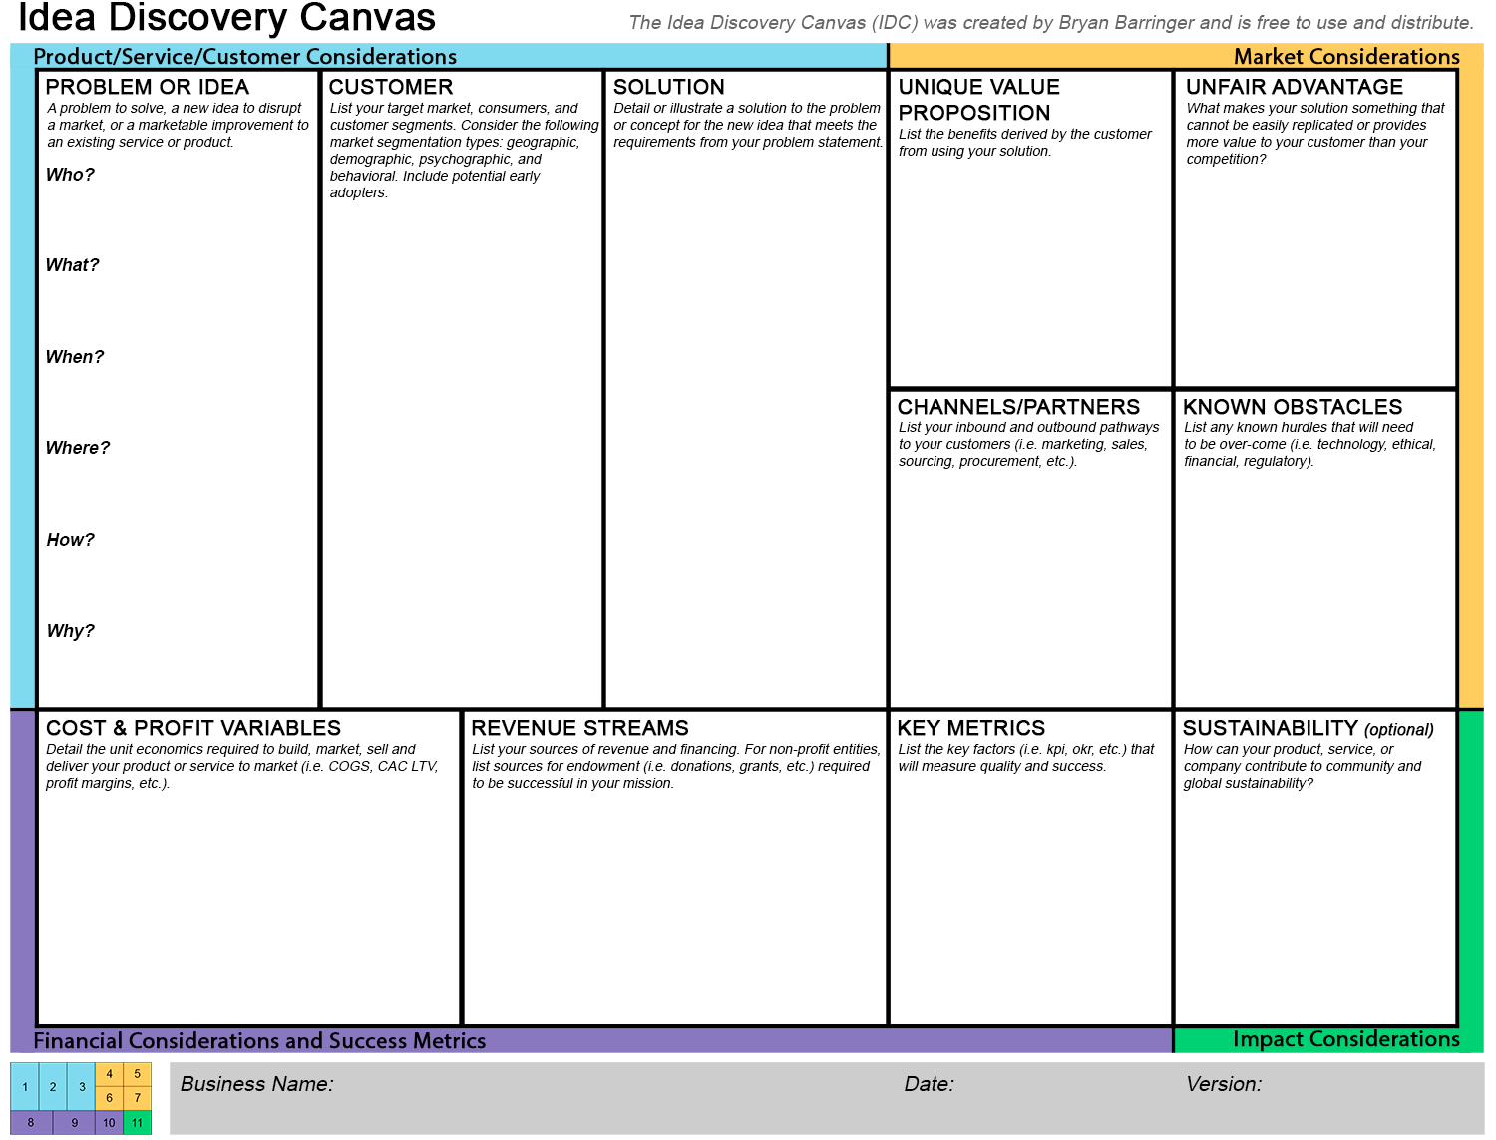

Slide 4
Problem
What’s the Pain/Problem that you seek to solve?
State the big, important, scary problem that your company is going to solve.
State concisely and clearly why this situation exists and persists.
State the impact this problem has on the market.
Avoid asking the audience a question…and certainly don’t wait for a response if you do.
Often, if you ask a question (“How many of you have every experienced…”), for those who have NOT experienced what you are asking about, they may checkout on you as you have basically excluded them from the problem that you are trying to set the stage.
Pro Tip: The purpose of this deck is to tell a story or narrative so that your audience will associate with the problem and and empathize with the customer.

Slide 5
Market & Customer
Who is suffering from this problem?
How big is the pain/problem?
Assert the size of the opportunity you have identified – use real numbers
Quantify the pain.
Define the scope of the opportunity.
Avoid talking about the following (at this point in deck/pitch):
Total Addressable Market (TAM)
Serviceable Addressable Market (SAM)
Share of Market (SOM)
Detail customer segmentation and groupings. (i.e Male/Female, ages 18-35, average income, etc.)
Pro Tip: Using more images WITH words, more than words alone, can illustrate your point more effectively.

Slide 6
Solution
What is your Solution?
State concretely what you will build that solves the problem.
Showing is better than telling.
Use animated of video-based demonstrations here. But beware of the technology used in the deck as it may fail during a presentation.
Pro Tip: By the time you present the solution, all or most of your audience should have that “ah ha” moment where they can see why this solution will solve the problem detailed in the slides before.

Slide 7
Unique Value Propositions (Benefits)
What are the benefits or value that your solution provides that will drive a customer to buy or use your solution?
State clearly and quantify to the extent possible the 3 to 5 key value propositions (benefits).
Pro Tip: Benefits help detail why your solution/product is worth buying and/or why your company is worth funding.

Slide 8
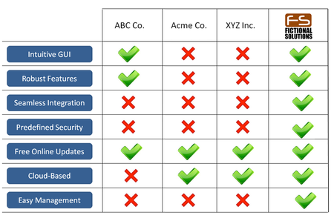
Competition & Unfair Advantages
Do you have intellectual property (protected, unique, or proprietary) that will allow your solution/company to have an unfair advantage over the competition?
Who else provides a similar solution and why is yours better?
State clearly and concisely how your solution is better than what everyone does in the industry, including the status quo.
Do your homework on the competition and don’t misrepresent their strengths or their weaknesses.
Illustrate your competitive advantage in a matrix table.
Pro Tip: A solution’s competitive advantage matrix is a good way to show clearly why your solution makes all others pale to compare.

Slide 9
Go-To-Market Strategy
How will you get your solution to the Market?
Where are your customers and how will you get to them?
Focus on articulating the non-obvious, potentially disruptive elements of your strategy.
Refer to data and insights received from potential purchasers during customer discovery.
What are the critical hurdles that the company faces and how will the company address them to get the sale?
Do your homework here and make this section strong.
Pro Tip: From the Idea Discovery Canvas, this is where you detail how you will distribute and scale your production/solution to your target market.

Slide 10
Business Model
If you can get your solution to the market, how will you make money?
How do you make money?
Explain the pricing, the costs, and why this company will be especially profitable.
Make sure you know the key assumptions underlying your planned success. Be prepared to defend them.
Be ready to articulate the sensitivity of your business to variations in your assumptions.
Pro Tip: Monetization is the term used to define how a product or solution will make money. Be considerate of all alternatives to creating revenue as it is not a one way fits all kind of deal.

Slide 11
Revenue Model
Assuming you can get it to market and make money, how much will you make? (Financial Projections Slide)
What is your financial projection for the company?
What are the two to four key metrics that will drive revenues, expenses and growth?
Convey that you really understand the economics and evolution of a growing a dynamic company.
It is OK to address the following at this point:
Total Addressable Market (TAM)
Serviceable Addressable Market (SAM)
Share of Market (SOM)
NOTE: Investors are very wary of founders that claim “huge” market potential along side a “conservative” share of the market that your company will “undoubtedly” achieve. You are NOT going to capture 2% of a $50 Billion market! This is a different conversation if you are already in the market with $500k in annual revenue with a huge scaling opportunity with a Series round… If you don’t have this and you are just a startup, express your knowledge of TAM/SAM but don’t make bold statements on how much of it you are going to grab.
Pro Tip: Be mindful not to put a cliché’ line/bar growth that shows a steady growth over time to some larger-than-life number. Be realistic and show them a number that is conservative but grows aggressively as you mature your company and solution in the market. The more you know the more you make..

Slide 12
Progress (Traction)
What achievements or progress has been made to date by the team? (Progress Slide)
What are the meaningful achievements already attained by your team to date?
Highlight the WOW moments! What has your team knocked out of the park. (I.e. milestones, strategic partners, contracts, traction, investment, REVENUE, etc.)
Pro Tip: Progress shows how much you have done to date and with what limited resources. This can be a critical decision point for investors. “Look what we have done with nothing. Imagine what we could do with money.”

Slide 13
Ask
What will be needed to succeed and how will you and others measure progress?
What are the capital requirements for the company?
Map the funding against your key milestones.
Tie the milestones to the key metrics in your financial projections
This is your operating plan for the funds you are raising – financing requirements and associated milestones.
Investors Want to See: (generally)
MVP from Friends & Family and small Angel Funding.
Revenue generating product in market with $10k MRR from Seed and large Angel Funding.
Significant ARR in multiple markets, with retention and repeat business and an opportunity to scale in a big way for Series A rounds.
$1 Billion and up valuation for Series B and above rounds.
Pro Tip: Many founders make the mistake of asking for too much or not nearly enough. Ensure that what you are asking for is justified and be prepared to defend this number with a real plan for its spend.

Slide 14
Team
Who is building the startup?
Founders with key and relevant accomplishments listed.
Include Advisors, Mentors and Subject Matter Experts that believe in you and your company and are actively advising you to help you succeed.
Who on this slide gives your team an edge.
Include investor firm names.
Consider showing a group shot if you have already grown your business to 5+ founders/employees.
Pro Tip: For many investors, the fund the who more than the what.

Slide 15
Thank You
Why you? Why now?
Solidify the core value proposition of your company in words that are memorable and unique to your company.
If someone were to give a short summary the company, these are the words you want used – the opportunity and the solution.
Include contact info and social media tags/handles.
Pro Tip: CLOSE STRONG. Be confident. Be proud yet humble for what you have accomplished and what you want out of your future.

Slide 16
Pro Tip: The Last Slide
Instead of a ”QUESTIONS” slide, show a slide that conveys a compelling piece of the story, data, or traction. This slide will have the most “on-air” time of any other side.

Slide 17
Pro Tip: Use Imagery
The use of imagery to support your narrative can leave a more lasting impression than just a bunch of words and bullet points on every page.

Slide 18
Get OCD
Everything counts for you or against you in a pitch. Don’t let your deck be a negative point.
Check each slide dozens of times for typos and grammatical mistakes.
Pay attention to alignment.
Don’t mix in a bunch of different fonts throughout the deck.
Be consistent.
Don’t over do the bullets.
Make sure your deck and verbal pitch match the time allotted.
PRACTICE. PRACTICE. PRACTICE.

